Slide 1

Proactive Burnout Prediction System Using AI
-Techxcelerate Hackathon 2024
Bits pillani hyderabad

Slide 2

PROBLEM STATEMENT
"Preventing burnout before it strikes: Workplace burnout often goes unnoticed until it’s too late, impacting employee well-being and productivity. There’s a need for proactive solutions that detect early signs of burnout by analyzing behavioral and productivity patterns, enabling timely support and intervention."
According to a recent survey,
- 51% of respondents reported having suffered burnout in the past year.
- 63% named mental and emotional stress as the top cause of burnout.

Slide 3

Our Solution: AI-Driven Burnout Prediction
UNSUPERVISED LEARNING

Slide 4
Overview:
Our solution leverages an AI-driven, unsupervised learning model to monitor employee well-being through proactive data analysis. By assessing behavior and productivity patterns, we can detect early signs of burnout and provide timely interventions.
Approach Steps:
Data Generation: We created synthetic employee data with key features like age, work hours, sentiment score, and workload.
Data Preprocessing: Cleaned and prepared data for model training, ensuring accuracy and consistency.
Feature Engineering: Enhanced features by deriving new, meaningful metrics based on existing data, focusing on burnout indicators.
One-Class SVM Modeling: Our unsupervised One-Class SVM model identifies outliers (burnout risks) as "-1" and normal cases as "+1," allowing early intervention.
Innovation and Scalability:
Real-time insights on burnout risk for timely HR or managerial action.
Scalable across industries due to synthetic data flexibility, enabling easy adaptation in various organizational setups.

Slide 5

Why One- Class SVM ?!
&
How we stand different ?

Slide 6
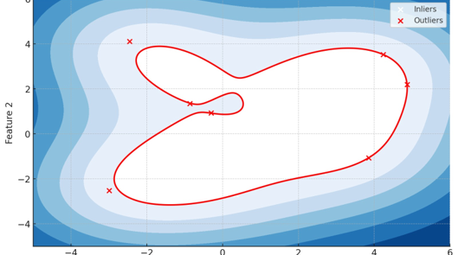
One-Class SVM
It is an unsupervised learning algorithm designed to detect anomalies or outliers in a dataset.
It’s particularly useful for identifying abnormal patterns, such as employees at risk of burnout, by classifying them as either normal or anomalous without requiring labeled data.
It works by learning the boundary of a "normal" class in the dataset, and then classifying any data point that falls outside this boundary as an anomaly or outlier, making it effective for detecting rare events like burnout risks in employees without needing labeled data.

Slide 7
How we stand apart ?
While most existing models are supervised, relying on labeled data that is often hard to obtain, and others use K-Means clustering, which struggles with identifying outliers in imbalanced datasets, our solution uses One-Class SVM. This method not only works without labeled data but also excels at detecting anomalies (like burnout) in complex, high-dimensional employee data, offering clear decision boundaries and flexibility for real-time, scalable predictions. This makes our approach uniquely suited for proactive burnout detection.
Conclusion:
Developing a model to predict corporate employee burnout is crucial for creating effective strategies to reduce the issue. Key recommendations include improving cognitive empathy, perceived empowerment, job clarity, and considering work preferences. However, the study's reliance on synthetic data limits the model's real-world applicability. Future research should use diverse, real-world data to enhance the model's generalizability and predictive accuracy across various corporate environments.

